Slide 1
BIG DATA TOOLS
MODULE 3

Slide 2
Last week
Hadoop ecosystem
Hive
Hortonworks sandbox

Slide 3

Learning Objectives
Apply basic Python programming constructs.

Slide 4
Programming paradigm
Declarative programming- describe the results but not how to get it
Imperative programming- opposite of declarative (detail oriented)
procedural programming (routines and functions)
functional programming (avoid changing state and mutable data)
object-oriented programming
https://en.wikipedia.org/wiki/Comparison_of_programming_paradigms

Slide 5
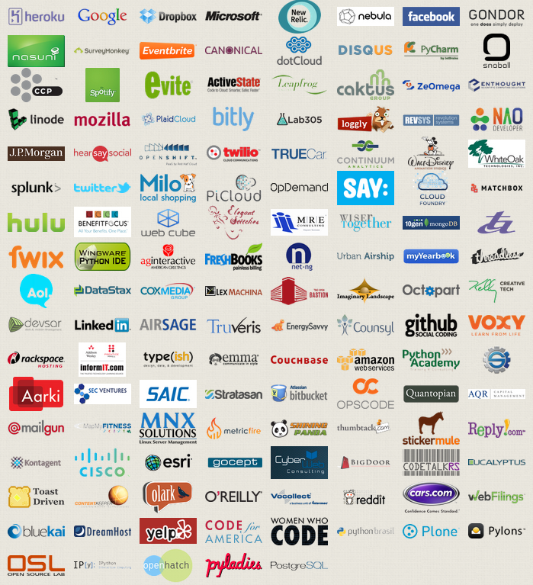
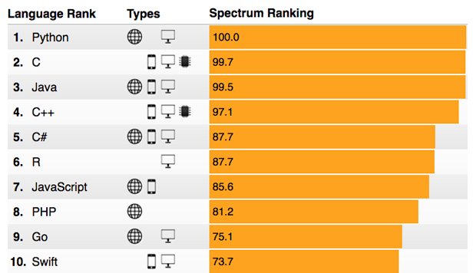
Why Python?
Open Source – free to install
Great online community
Easy to learn
language for data science and production of web based analytics products.
http://spectrum.ieee.org/computing/software/the-2017-top-programming-languages

Slide 6
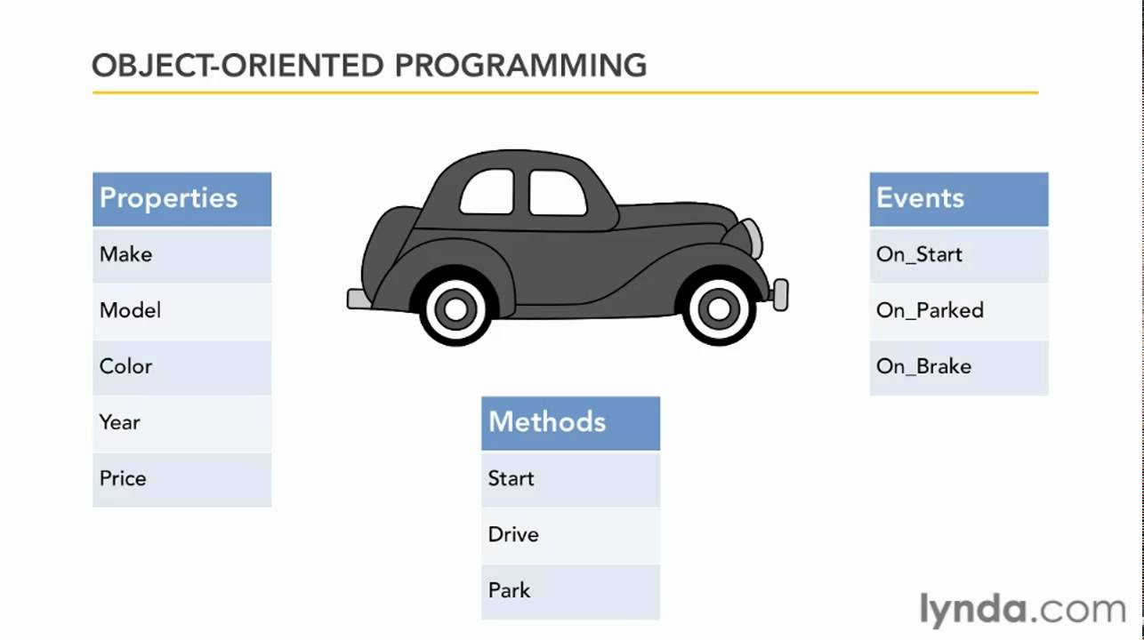
Object Oriented Programming
https://www.youtube.com/watch?v=NUl8lcbeN2Y

Slide 7
Compiler
We will be walking through this lesson using an online compiler located at: https://repl.it/languages/python
Please follow along using the compiler by inputting the commands under the “In Compiler:” header.
Notes:
Explain: open the compiler, explain functionality of compiler, editor window and output window, how to execute code

Slide 8
Print
Print command outputs the text contained inside the quotation marks.
Example:
Print (“Hello”)
In Compiler:
Print (“Ford, Toyota, Nissan”)
Notes:
Print (“Ford, Toyota, Nissan”)

Slide 9
Expression
In Python an expression is any combination of literals, identifiers, and operations that return a value
Assignemnt x=y
Operation x*y
Aggregation (x,y)
Simple value y
Constant value True
Result of a function call func()

Slide 10
Statement
A piece of code which could be an import of library, statement , loop, break or continue.
It does not require a semicolon at the end of line
You can define a block of code using indent. No bracket or other identifier is needed.

Slide 11
Variables and Types
Variables are used to store and manipulate data.
No need to declare but need to assign (initialized)
Various Types:
Integers: whole number. Ex: 10
Floats: decimal number. Ex: 7.3
Strings: text. Ex: “hello”
Example:
mystring = ‘hello’
myint = 10
In Compiler:
carcolour = “Red”
numberofseats = 4
Print(carcolour)
Print(numberofseats)

Slide 12
Variable names
Can contain letters, numbers, and underscores
Must begin with a letter
Cannot be one of the reserved Python keywords: and, as, assert, break, class, continue, def, del, elif, else, except, exec, finally, for, from, global, if, import, in, is, lambda, not, or, pass, print, raise, return, try, while, with, yield

Slide 13
More on variable names
Names starting with one underscore (_V) are not imported from the module import * statement
Names starting and ending with 2 underscores are special, system-defined names (e.g., __V__)‏
Names beginning with 2 underscores (but without trailing underscores) are local to a class (__V)‏

Slide 14
Operators
+ addition
- subtraction
/ division
** exponentiation
% modulus (remainder after division)‏
Comparison operators in Chapter 2

Slide 15
Lists
What is an array?
List is Python’s version of array. Can contain any mix of variable types
Example:
mylist = []
List2=list()
mylist.append(1)
mylist.append(“hello”)
print(mylist[0])
print( len(mylist)) # len() returns the number of elements in the list
In Compiler:
carlist = []
carlist.append(“Toyota”)
carlist.append(“Nissan”)
Carlist.append([“Fiat”,”Mazda”])
dir(carlist )
dir(list())
Notes:
Explain concept of index for arrays
Ask the class: How can we print just Nissan?

Slide 16
Dictionary
A mutable collection of key-value pairs
Unlike list, dictionaries don’t organize data into sequences, but pairs
Example:
myDictionary = {}
Dict2=dict({1:2})
myDictionary[“a”]=1
myDictionary.update({“hello”:”world”})
print(myDictionary )
print(len(myDictionary ))
In Compiler:
dir(dict())
dir({})
myDictionary = {}
Dir(myDictionary)

Slide 17
Operators
Arithmetic operators:
+,-,/,*…
Print(1+3)
String operators
Print(“hello”+” “+”world”)
List operators
list1 = [1,2,3]
list2 = [4,5,6]
Print(list1+list2)
In Compiler:
brand = “Nissan”
numberofseats = 4
Print(“The “+ brand + “has “ + numberofseats + “ seats”)

Slide 18
Data Manipulation
Arithmetic operators:
+,-,/,*…
Print(1+3)
String operators
Print(“hello”+” “+”world”)
List operators
list1 = [1,2,3]
list2 = [4,5,6]
Print(list1+list2)
In Compiler:
brand = “Nissan”
Print(“The car is a ” + brand)
Print (brand[2:4])
brand[3]=‘M’

Slide 19
Concatenation
Joining of variables
Concatenating two strings
Print(“hello” + “world”)
Concatenating a string and an integer
Print(“hello” + 9)
Cannot concatenate a string and other data type
Instead use str()
Print(“hello” + str(9))
In Compiler:
brand = “Nissan”
Numberofseats
Print(“The ” + brand + “ has ” + str(numberofseats) + “ seats.”)

Slide 20
By value / by reference
Everything in Python is a reference.
However, note also that immutable objects are not changeable
changes to immutable objects within a function only change what object the name points to (and do not affect the caller, unless it's a global variable)‏
For immutable objects (e.g., integers, strings, tuples), Python acts like C's pass by value
For mutable objects (e.g., lists), Python acts like C's pass by pointer; in-place changes to mutable objects can affect the caller

Slide 21
Reference semantics
A=4
B=A
B=6
print(A)
A=[1,2,3]
B=A
B.append(4)
print(B)

Slide 22
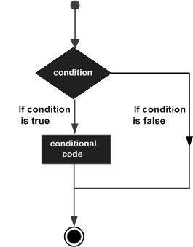
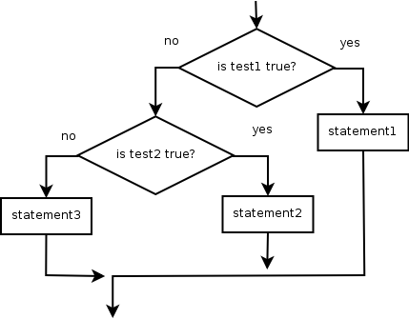
Conditionals
Used to test if a condition is true
The IF statement general structure:
If something is true/false
Do something
To test for equality: ==
To test for inequality: !=
In Compiler:
Car = “Toyota”
If car == “Toyota”
Print(“The car is a Toyota”)

Slide 23
And/Or
We can evaluate multiple statements with logical and/or
Example 1 (and):
If day == “Monday” and meetings == 2:
print(“You have 2 meetings on Monday”)
Example 2 (or):
if fruit == “apple" or fruit == “orange":
print("The fruit is either an apple or an orange")
In Compiler:
Car = “Toyota”
Numberofseats = 4
Determine if a car is a 4-door Toyota
Notes:
Provide other examples of Boolean logic with multiple cases

Slide 24
Else
The else statement allows us to have a default condition
Example 1 (else):
x = “Steve”
if x == “Steve”:
print(“It’s Steve”)
else:
print(“It’s not Steve”)
In Compiler:
Car = “Toyota”
Determine if a car is a Toyota. If not, print a message saying so.

Slide 25
elif
The elif statement allows us to have multiple if conditions
Example 1 (elif):
x = “Steve”
if x == “Steve”:
print(“It’s Steve”)
elif x == “John”:
print(“It’s John”)
else:
print(“It’s not Steve or John”)
In Compiler:
Car = “Toyota”
Determine if a car is a Toyota, or a Ford. If not, print a message saying so.

Slide 26
In
Membership operations
x = 'Hello world‘
y = {1:'a',2:'b'}
print('H' in x) ➔ Output: True
print('hello' not in x) ➔# Output: True
print(1 in y) ➔ Output: True
print('a' in y) ➔ Output: False

Slide 27
Loops
for x in range(1, 6):
print x, "squared is", x * x
Output:
1 squared is 1
2 squared is 4
3 squared is 9
4 squared is 16
5 squared is 25
for loop: Repeats a set of statements over a group of values.
for variableName in groupOfValues:
statements
Control statement: break, continue, pass
We indent the statements to be repeated with tabs or spaces.
variableName gives a name to each value, so you can refer to it in the statements.
groupOfValues can be a range of integers, specified with the range function.

Slide 28
Loops
In Compiler:
Create a list of cars
Use a for loop to print the list of cars

Slide 29
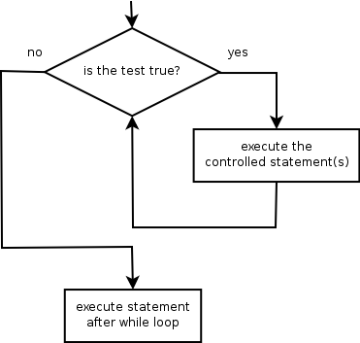
Loops
while loop: Executes a group of statements as long as a condition is True.
good for indefinite loops (repeat an unknown number of times)
Control statement: break, continue, pass
Example:
number = 1
while number < 200:
print number,
number = number * 2
Output:
1 2 4 8 16 32 64 128

Slide 30
Function
Functions provide a way to create reusable blocks of code.
Can call a function many times instead of writing the same code repeatedly
A function is introduced by def, a name, and a parameter list, followed by an indented block of code.
def circle_area (radius):
return math.pi * (r**2)
B=circle_area(6)
In Compiler:
Define a function which has one parameter (a list of car brands) and returns the first brand in the list.

Slide 31
The def statement
The def statement is excecuted (that's why functions have to be defined before they're used)‏
def creates an object and assigns a name to reference it; the function could be assigned another name, function names can be stored in a list, etc.
Can put a def statement inside an if statement, etc!

Slide 32
More about functions
Arguments are optional. Multiple arguments are separated by commas.
If there's no return statement, then “None” is returned. Return values can be simple types or tuples. Return values may be ignored by the caller.
Functions are “typeless.” Can call with arguments of any type, so long as the operations in the function can be applied to the arguments. This is considered a good thing in Python.

Slide 33
Multiple return values
Can return multiple values by packaging them into a tuple def onetwothree(x): return x*1, x*2, x*3 print (onetwothree(10)) 10, 20, 30

Slide 34
Classes and Objects
A class is an object blueprint which defines how to build a certain kind of object.
The class may have internal functions (called methods) can store some data items that are shared by all the instances of this class.
Instances are objects that are created which follow the definition given inside of the class

Slide 35
Classes and Objects
class student:
def __init__(self,n,a): self.full_name = n self.age = a
def get_age(self): return self.age
mike=student(“Mike”,18)
Print mike.get_age()
There must be a special first argument self in all of method definitions which gets bound to the calling instance.
__init__ serves as a constructor for the class. Usually does some initialization work.
There’s also no “destructor” method for classes (automatic garbage collection)

Slide 36
Classes and Objects
class student:
def __init__(self,n,a): self.full_name = n self.age = a
def get_age(self): return self.age
mike=student(“Mike”,18)
print (mike.get_age())
In Compiler:
Define a class named car
Create variables for brand, colour, and number of seats
Create functions to set and return the above variables
Create a new instance of a car and test your class functions

Slide 37
Built-In Members of Classes
Classes contain many methods and attributes that are included by Python even if you don’t define them explicitly.
Most of these methods define automatic functionality triggered by special operators or usage of that class.
All built-in members have double underscores around their names: __init__ __doc__
Here are the methods for student class:
>>> dir(student)
['__class__', '__delattr__', '__dict__', '__dir__', '__doc__', '__eq__', '__format__', '__ge__', '__getattribute__', '__gt__', '__hash__', '__init__', '__le__', '__lt__', '__module__', '__ne__', '__new__', '__reduce__', '__reduce_ex__', '__repr__', '__setattr__', '__sizeof__', '__str__', '__subclasshook__', '__weakref__', 'get_age']

Slide 38
Packages
Collection of premade functions
Must be loaded first using import
Example:
Import packagename
Useage:
Packagename.function(parameters)

Slide 39
Python anatomy - Modules and packages
Python modules are used to organize Python code. For example, database related code is placed inside a database module, security code in a security module etc.
It becomes more and more useful when dealing with larger programs.
Modules are grouped together to form packages.
A module name is the file name with the .py extension.
When we have a file called empty.py, empty is the module name. The __name__ is a variable that holds the name of the module being referenced.
The current module, the module being executed (called also the main module) has a special name: '__main__'. With this name it can be referenced from the Python code.
The main difference between a module and a package is that a package is a collection of modules AND it has an __init__.py file

Slide 40
Module installation
Mac or linux :
curl -O https://bootstrap.pypa.io/get-pip.py
Sudo python get-pip.py
Windows:
https://github.com/BurntSushi/nfldb/wiki/Python-&-pip-Windows-installation
pip install <package name>
http://docs.python.org/tutorial/modules.html

Slide 41
Frequently used modules
cmp Utilities for comparing ﬁles and directories
glob Finds ﬁles matching wildcard pattern
re Regular expression string matching
time Time and date handling
datetime Fast implementation of date and time handling
doctest, unittest Modules that facilitate unit test
sys Information about Python itself (path, etc.)
os Operating system functions
os.path Portable pathname tools
shutil Utilities for copying ﬁles and directory trees

Slide 42
More frequently used modules
pdb Debugger
hotshot Code proﬁling
pickle, cpickle, marshal, shelve Used to save objects and code to ﬁles
getopt, optparse Utilities to handle shell-level argument parsing
math, cmath Math functions (real and complex) faster for scalars
random Random generators (likewise)
gzip read and write gzipped ﬁles
struct Functions to pack and unpack binary data structures
StringIO, cStringIO String-like objects that can be read and written as ﬁles (e.g., in-memory ﬁles)
types Names for all the standard Python type

Slide 43
Python Modules for Data Science
Data analysis
pandas, numpy, networkx
Machine learning
scikits.learn, milk
Scientiﬁc
scipy, pyephem, astropysics
Visualization
matplotlib, d3py, ggplot
Big Data:
pyspark
https://medium.com/activewizards-machine-learning-company/top-15-python-libraries-for-data-science-in-in-2017-ab61b4f9b4a7

Slide 44
Excercise 2- Inspecting module methods
>>> import numpy
>>> dir(numpy)
['ALLOW_THREADS', 'BUFSIZE', 'CLIP', 'ComplexWarning', 'DataSource', 'ERR_CALL', 'ERR_DEFAULT', 'ERR_DEFAULT2', 'ERR_IGNORE', 'ERR_LOG', 'ERR_PRINT', 'ERR_RAISE', 'ERR_WARN', 'FLOATING_POINT_SUPPORT', 'FPE_DIVIDEBYZERO', 'FPE_INVALID', 'FPE_OVERFLOW', 'FPE_UNDERFLOW', 'False_', 'Inf', 'Infinity', 'MAXDIMS', 'MachAr', 'NAN', 'NINF', 'NZERO', 'NaN', 'PINF', 'PZERO', 'PackageLoader', 'RAISE', 'RankWarning', 'SHIFT_DIVIDEBYZERO', 'SHIFT_INVALID', 'SHIFT_OVERFLOW', 'SHIFT_UNDERFLOW', 'ScalarType', 'Tester', 'True_', 'UFUNC_BUFSIZE_DEFAULT', 'UFUNC_PYVALS_NAME', 'WRAP', '__NUMPY_SETUP__', '__all__', '__builtins__', '__config__', '__doc__', '__file__', '__git_revision__', '__name__', '__package__', '__path__', '__version__', '_import_tools', '_mat', 'abs', 'absolute', 'add', 'add_docstring', 'add_newdoc', 'add_newdocs', 'alen', 'all', 'allclose', 'alltrue', 'alterdot', 'amax', 'amin', 'angle', 'any', 'append', 'apply_along_axis',
...
'typeNA', 'typecodes', 'typename', 'ubyte', 'ufunc', 'uint', 'uint0', 'uint16', 'uint32', 'uint64', 'uint8', 'uintc', 'uintp', 'ulonglong', 'unicode', 'unicode0', 'unicode_', 'union1d', 'unique', 'unpackbits', 'unravel_index', 'unsignedinteger', 'unwrap', 'ushort', 'vander', 'var', 'vdot', 'vectorize', 'version', 'void', 'void0', 'vsplit', 'vstack', 'where', 'who', 'zeros', 'zeros_like']
Notes:
44

Slide 45
Exercise 3
Write a class with two methods a to reverse an string
Function1(“hello world!”) returns “world! hello”
Function2(“hello world!”) returns “!dlrow olleh”
Write a Python program to construct the following pattern, using a nested for loop.
*
* *
* * *
* * * *
* * * * *
* * * *
* * *
* *
*

